Slide 1
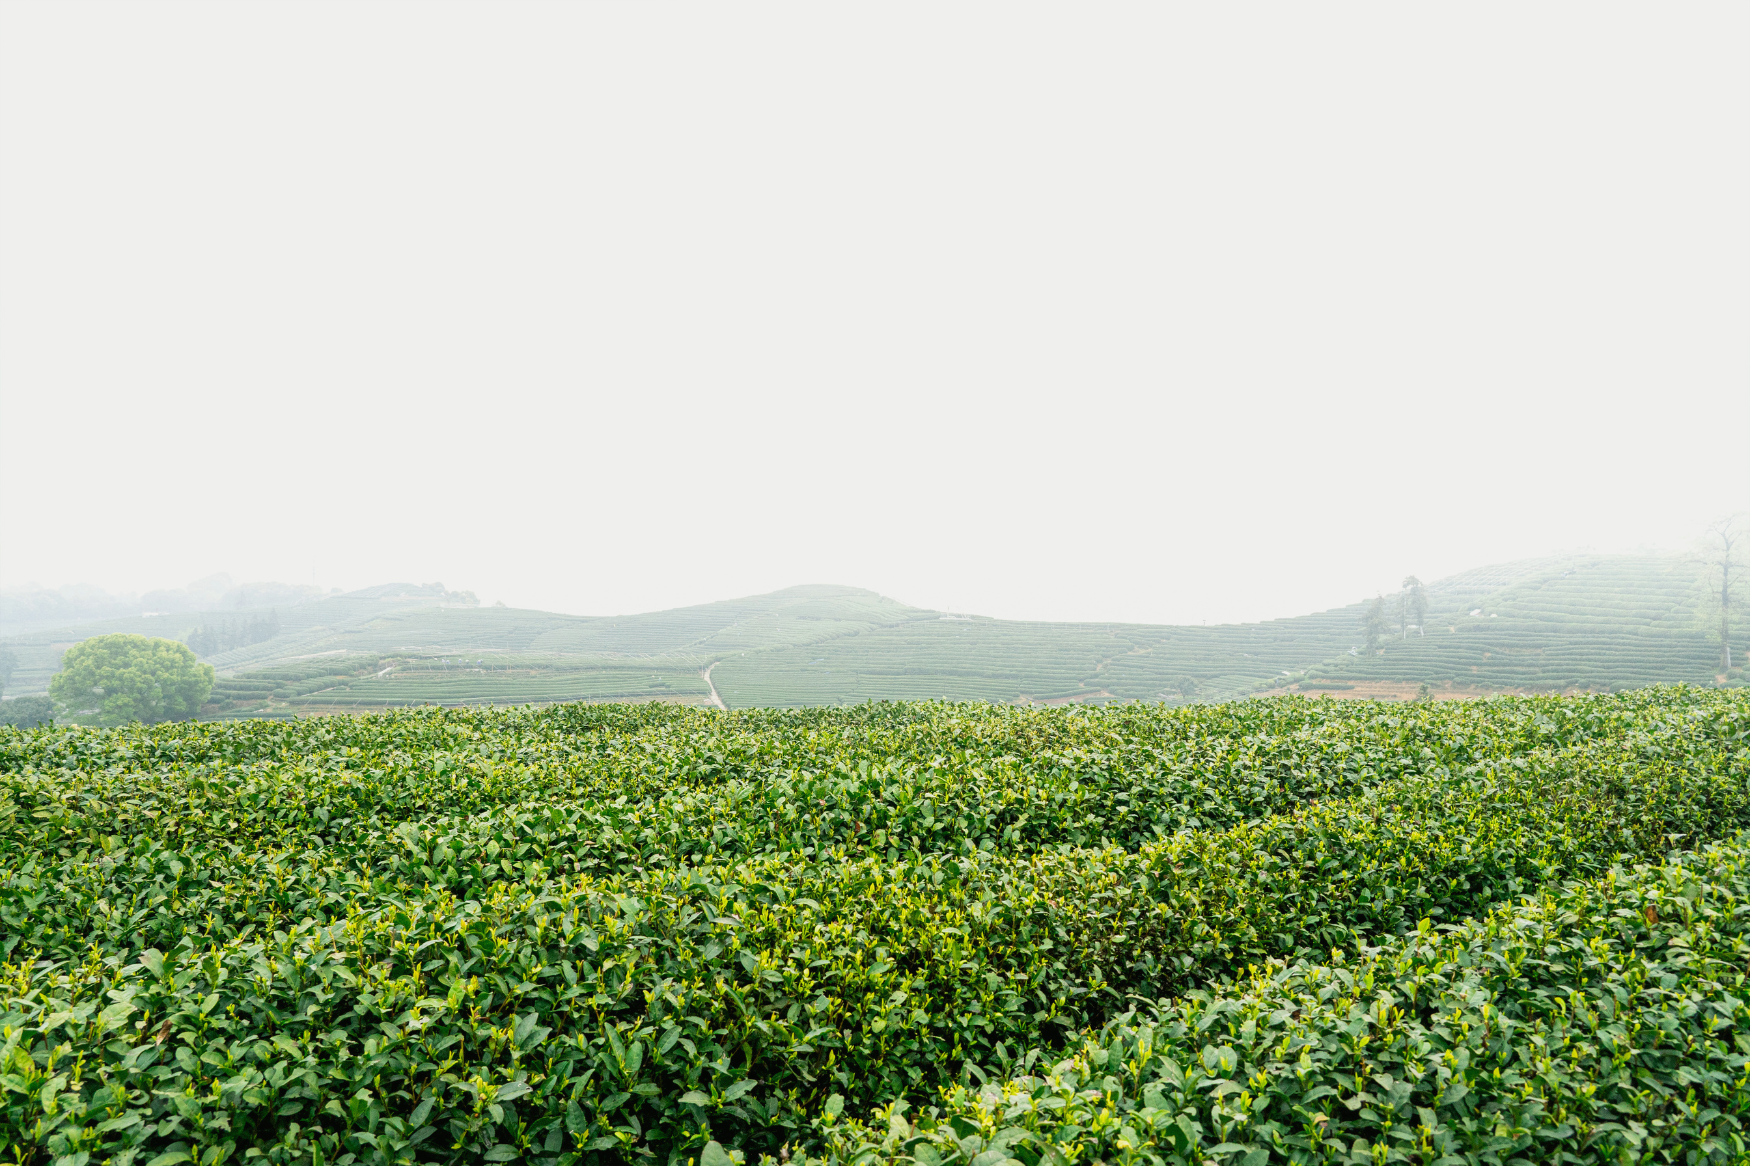


Plant Disease Detector
Submitted By: Garv Jhuremalani
Registration No: 2427030363
Supervised By:
Dr. Ashok Kumar Saini

Slide 2
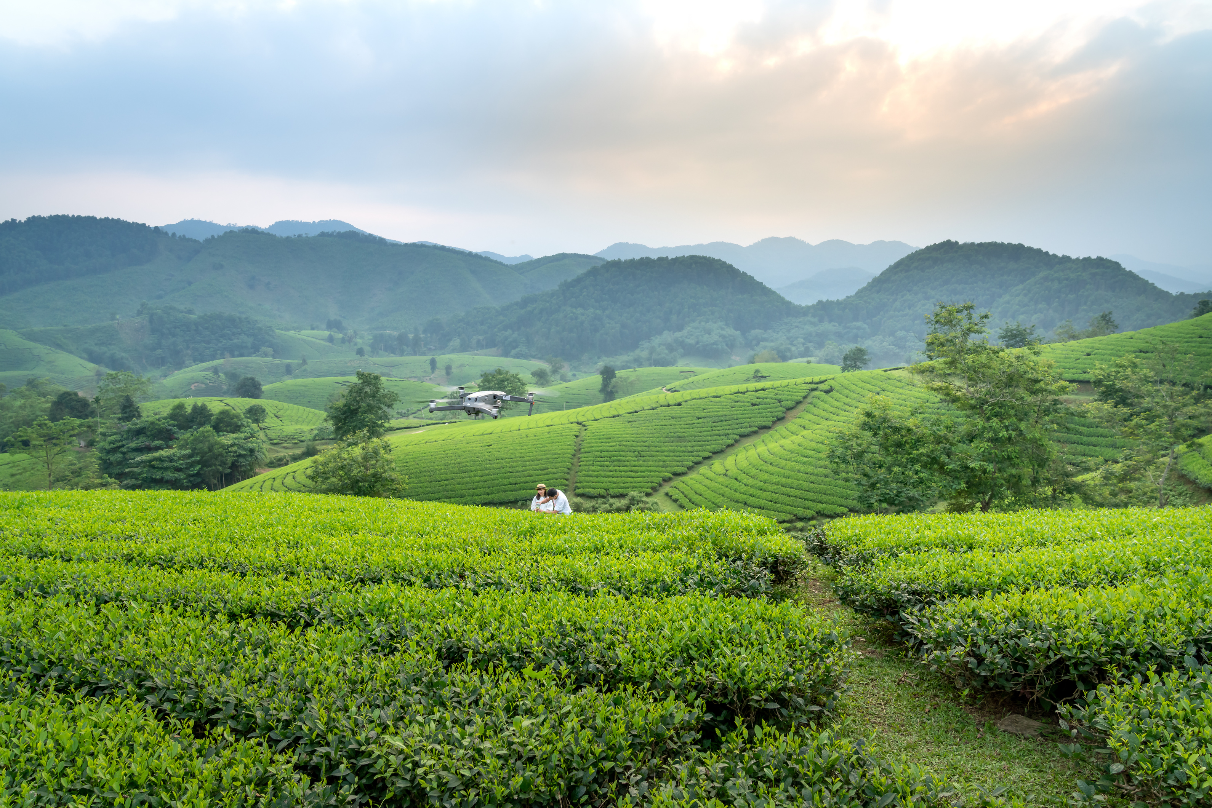
01
Introduction
02
Literature Review
03
Problem Statement
outline
04
Proposed Solution
05
Objectives

Slide 3
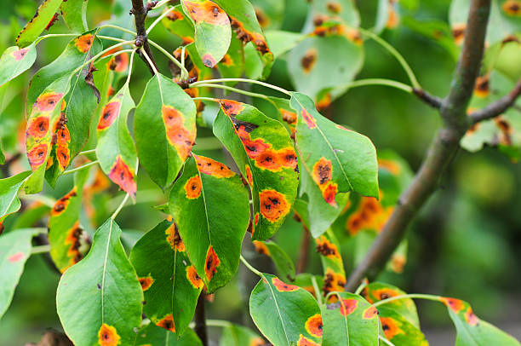
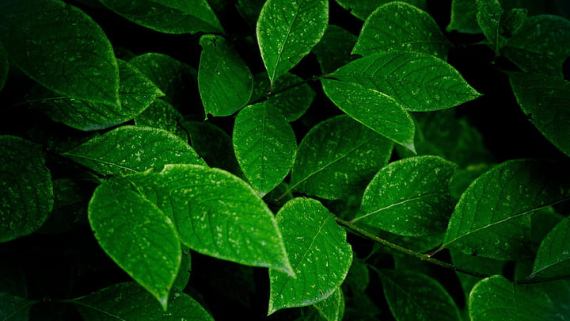
introduction
UNHEALTHY LEAVES
Agriculture forms the foundation of India’s economy, providing livelihood to millions.
Plant diseases pose a serious threat to crop yield, food security, and farmer income.
Traditional detection methods rely on human expertise, which is often unavailable in rural areas.
With advancements in Artificial Intelligence (AI) and Machine Learning (ML), image-based disease detection has emerged as a smart, scalable, and reliable approach.
This project focuses on building a system that can automatically analyze plant leaf images and identify diseases with high accuracy.
HEALTHY LEAVES

Slide 4
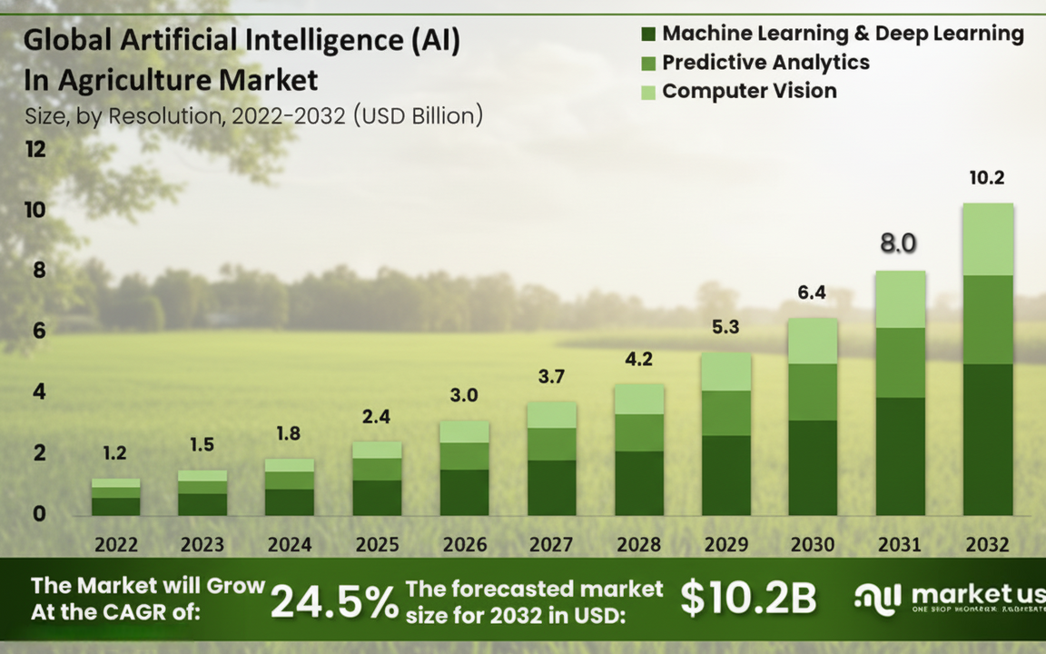
The global AI in agriculture market is projected to grow from $1.2 billion in 2022 to $10.2 billion by 2032.
This represents a compound annual growth rate (CAGR) of 24.5% — a strong indicator of how rapidly AI technologies are being adopted in farming.
Major contributing fields include:
Machine Learning & Deep Learning (disease prediction, crop yield estimation)
Predictive Analytics (weather and soil forecasting)
Computer Vision (leaf disease detection, crop monitoring)
These technologies are revolutionizing smart farming and enabling data-driven agricultural decisions.
introduction-
significance
8.0

Slide 5
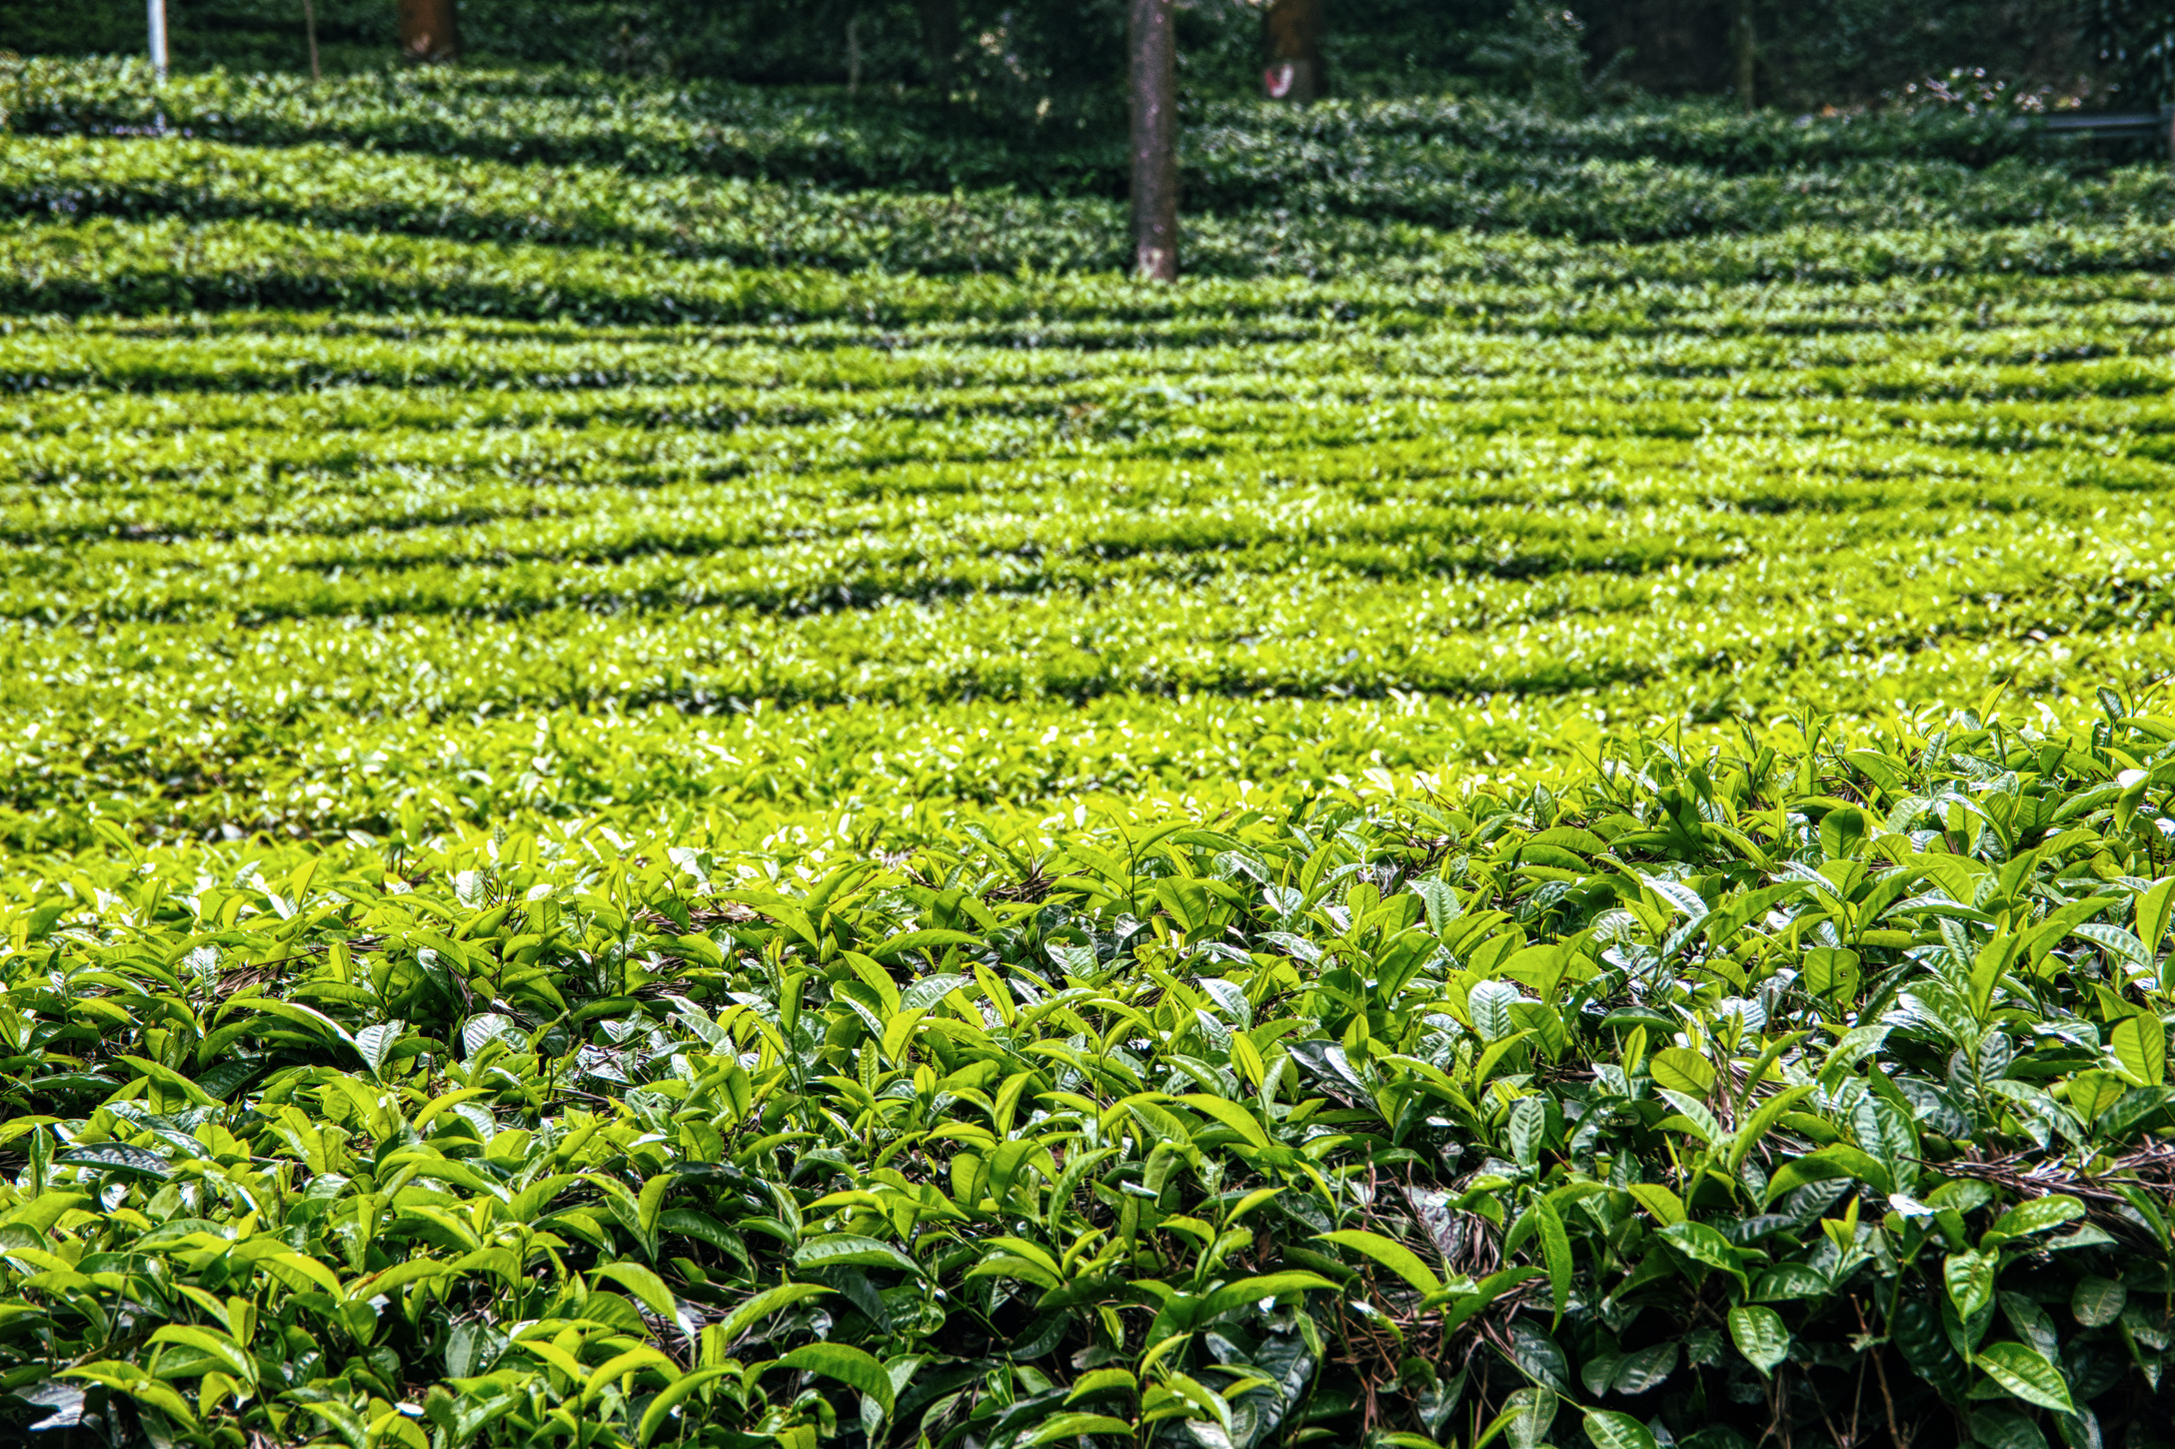
literature
review
Early Stage (before 2016): Focused on manual feature extraction (color, texture, shape) using ML algorithms like SVM, KNN, and Decision Trees.
Accuracy was often below 90%, limited by lighting conditions, camera angles, and leaf background noise.
Breakthrough: Mohanty et al. (2016) introduced deep CNNs (AlexNet, GoogLeNet) using the PlantVillage dataset (54K images), achieving 99% accuracy under controlled conditions.
Advancement: Ferentinos (2018) expanded this work, comparing AlexNet, VGG, Inception, and ResNet, achieving 97–99% accuracy even with diverse datasets.
These two studies laid the foundation for modern deep-learning-based agriculture AI systems.

Slide 6
Authors: Mohanty, P., Hughes, D. P., & Salathé, M.
Published in: Frontiers in Plant Science (2016)
Dataset: Introduced the PlantVillage dataset with 54,306 labeled images across 38 disease classes.
Methodology: Applied AlexNet and GoogLeNet (Inception v1) using transfer learning for leaf image classification.
Results: Achieved up to 99.35% accuracy under controlled conditions.
Key Contribution:
Proved CNNs could automatically learn disease features without manual preprocessing.
Established PlantVillage as the benchmark dataset for agricultural AI research.
Highlighted the challenge of adapting to real-field environments.
Foundational Work
Mohanty et al. (2016)

Slide 7
Authors: Ferentinos, K. P.
Published in: Computers and Electronics in Agriculture (2018)
Dataset: Extended dataset with ~87,000 images of various crops and diseases, including real-field samples.
Methodology: Compared multiple CNN architectures — AlexNet, VGG, Inception, and ResNet.
Results: Achieved 97–99% accuracy, with ResNet and VGG performing best.
Key Contribution:
Provided the first comprehensive comparison of deep CNN models for agricultural images.
Demonstrated model generalization across crop species.
Guided later researchers in choosing and optimizing CNN architectures for precision agriculture.
Comparative Deep CNN Models
Ferentinos (2018)

Slide 8
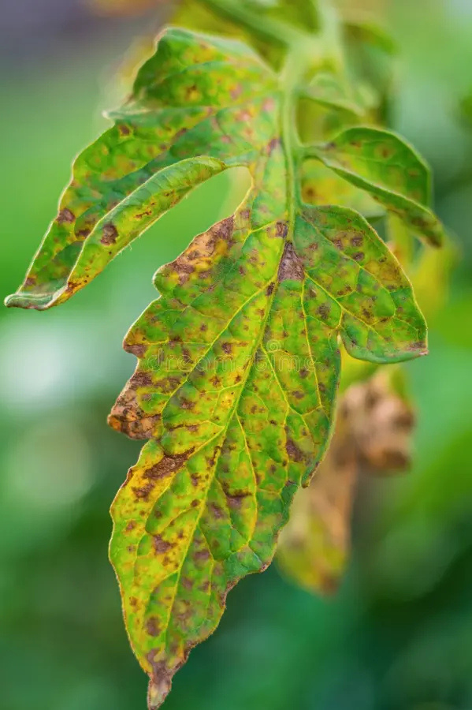
problem
statement
Plant diseases cause significant crop losses, and current manual inspection methods are time-consuming, error-prone, and require expert knowledge, creating a need for an automated, accurate, and fast system to detect plant diseases from leaf images.

Slide 9
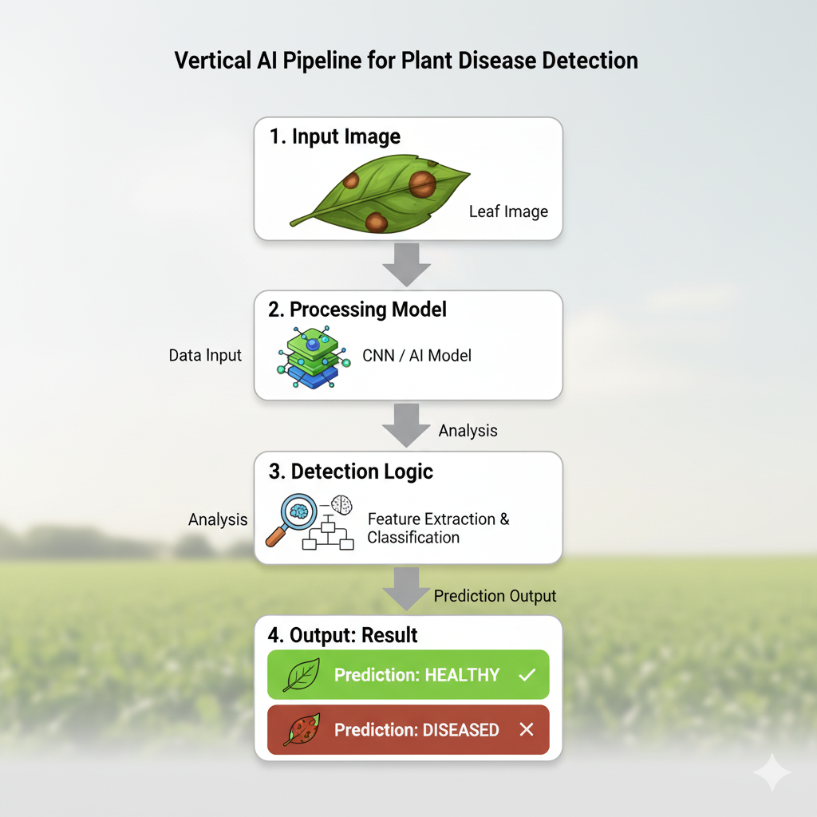
proposed
solution
Develop an AI-based system to detect plant diseases from leaf images.
Use Deep Learning (CNNs) to automatically learn disease features without manual preprocessing.
Utilize the PlantVillage dataset for training and validation.
Implement transfer learning with pre-trained models like EfficientNet, VGG16, or ResNet for higher accuracy.
Deploy a user-friendly interface (mobile app or web app) for farmers to upload leaf images and get instant disease predictions.

Slide 10
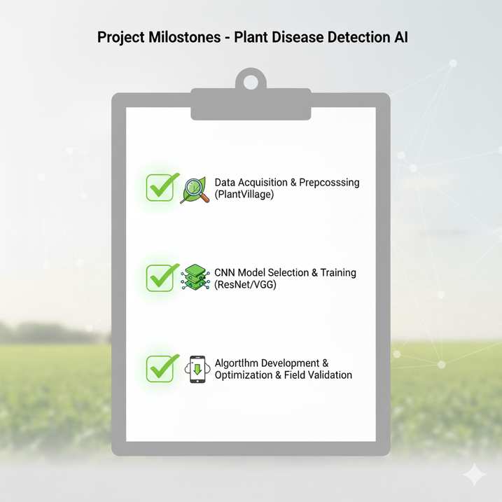
objectives
Automate disease detection to reduce dependence on manual inspection.
Achieve high accuracy in classifying multiple plant diseases.
Make the system user-friendly for farmers and agricultural experts.
Handle real-field variations like lighting, background, and leaf orientation.
Provide quick results for early disease management and prevention.
Visualize affected areas on leaves to aid understanding.

Slide 11
Mohanty, S.P., Hughes, D.P., & Salathé, M. (2016). Using deep learning for image-based plant disease detection. Frontiers in Plant Science, 7, 1419. https://doi.org/10.3389/fpls.2016.01419
Ferentinos, K.P. (2018). Deep learning models for plant disease detection and diagnosis. Computers and Electronics in Agriculture, 145, 311–318. https://doi.org/10.1016/j.compag.2018.01.009
PlantVillage Dataset – Kaggle Repository: https://www.kaggle.com/datasets/emmarex/plantdisease
TensorFlow Documentation – Model Building and CNN Implementation: https://www.tensorflow.org
PyTorch Documentation – Deep Learning Framework: https://pytorch.org
PlantVillage Project – Penn State University Agricultural Initiative: https://plantvillage.psu.edu
FAO (Food and Agriculture Organization) – Reports on Crop Diseases and Impacts: https://www.fao.org
references

Slide 12
thank you

